Slide 1
Angular JS

Slide 2
Introduction
Introduction of AngularJS
Fundamentals
Sample AngularJS Applications

Slide 3
About
Developed in 2009 by Misko and Adam Abrons
It is open source and completely free
Licensed under Apache and maintained by Google
Very Powerful Javascript framework
Used to create SPA project

Slide 4
Features of Angular JS
Used to create RIA
Helps to write an application using MVC architecture
Application in Angular JS is cross-browser compliant
Automatically handles javascript code as per browser

Slide 5
Architectural Pattern
Provides reusable solution
Similar to software design pattern, but have a broader scope
Example of Architectural pattern- Event driven architecture, MVP, MVVM, MVC etc.

Slide 6
Model View Controller
Is a software architectural pattern for implementing user interface on computers
MVC divides a given software application into 3 interconnected parts:
Model: to manages any data or logic throughout the application
View: can be any output representation of information(User interface)
Controller: accepts input and converts it to commands for the model view(Control overall application)

Slide 7
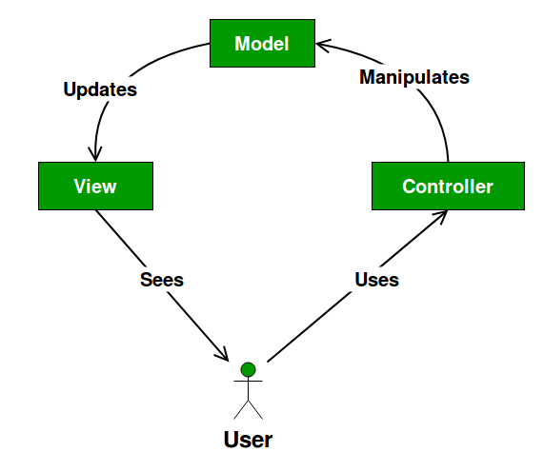

Slide 8
Benefits of MVC
Reusability
Decoupled code- if one layer update it will not affect to other layer of application.
Parallel development- Design and development of controller are possible together.
Multi view support- views are quite independent to particular model, can use different view to show same model.

Slide 9
Angular JS Directives
Markers on a DOM element
Tells compiler to attach a specified behaviour to DOM element
Angular JS comes with set of predefined directives
Developer can create custom directives

Slide 10
Directive List
ng-app
ng-model
ng-bind
ng-controller
ng-value
ng-show
ng-hid
ng-init
ng-repeat
ng-click
ng-disabled
ng-required

Slide 11
Filters
uppercase
lowercase
currency
orderBy
filter

